Slide 1
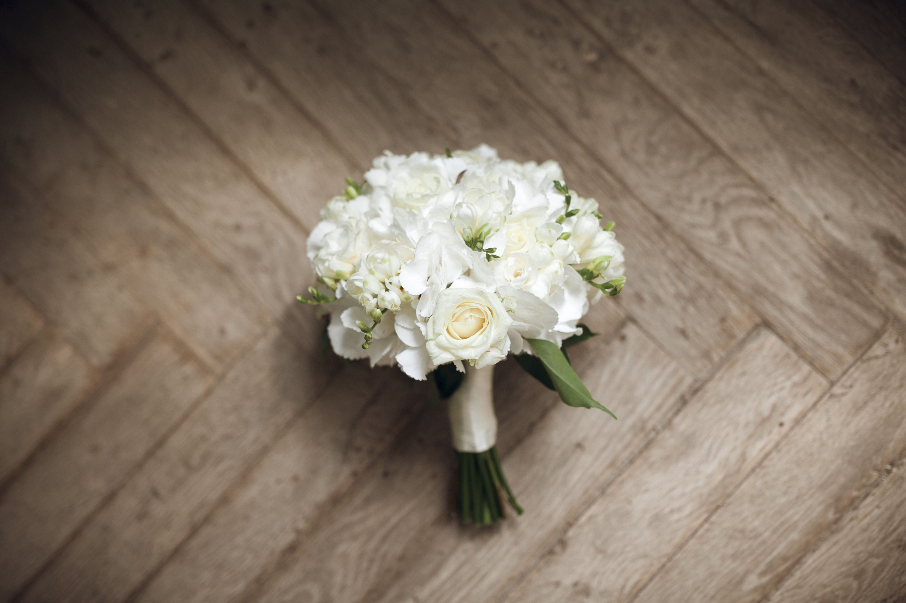
Floral Picture Slide 1
Flower Bouquet Making
Shawna Tuli
(shawna.tuli@avanade.com)
Northern California Wellness

Slide 2
Fill your vase halfway with water and add a teaspoon of sugar or the packet that comes with your flowers.
Remove any leaves from the bottom of the stems. Water will sour if foliage sits below the surface.
Trim the end of the stems, cutting at a diagonal angle. Place in water immediately for a longer-lasting arrangement.
Start with the greenery and place in the vase with the tip in water. Overlap the stems to form a framework.
Add volume by adding filler and secondary flowers. These will fill in gaps between the larger flowers.
Add the focal flowers. Make sure to place them evenly and spread out the colors.
Add any finishing touches, such as more filler, to help shape the arrangement or to add fullness.
Step back and view the arrangement from all sides to make sure it is balanced. Refine and adjust as needed.
You have completed a DIY bouquet! Make sure to change or replace the water every few days.

